Slide 1
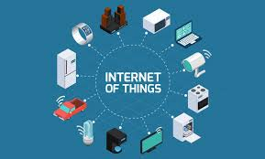
Internet Of Things
ION

Slide 2
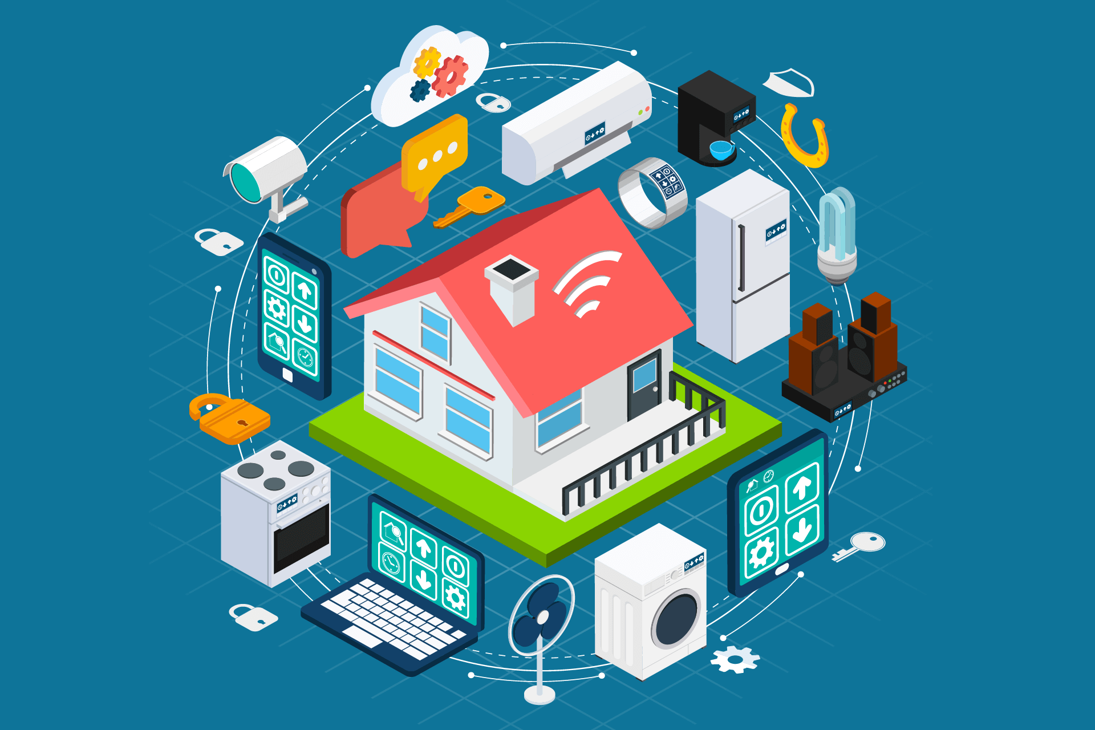
What is IOT?
The Internet of Things is an emerging topic of technical, social, and economic significance. Consumer products, durable goods, cars and trucks, industrial and utility components, sensors, and other everyday objects are being combined with Internet connectivity and powerful data analytic capabilities that promise to transform the way we work, live, and play. Projections for the impact of IoT on the Internet and economy are impressive, with some anticipating as

Slide 3
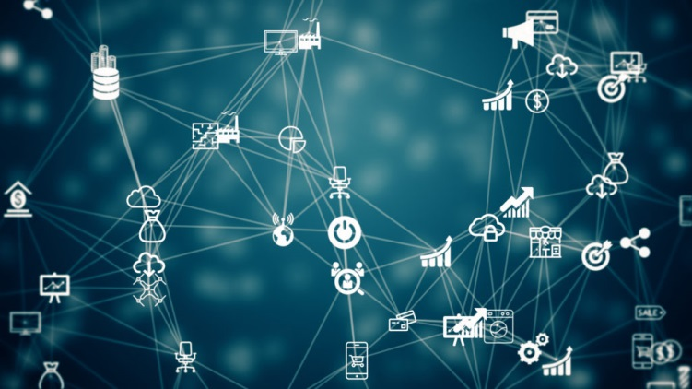
What is the history of ios?
The Internet, itself a significant component of the IoT, started out as part of DARPA (Defense Advanced Research Projects Agency) in 1962, and evolved into ARPANET in 1969. In the 1980s, commercial service providers began supporting public use of ARPANET, allowing it to evolve into our modern Internet

Slide 4
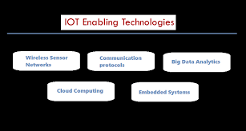
What technologies enable iot

Slide 5
Iot impacts
iot devices impact society in a meaningful way. Smart homes and offices can save energy costs by controlling the electricity or temperature when one is away from home or work, and they can offer better security by constant surveillance and taking proactive action in case of a security breach
The positive impact of the IoT on citizens, businesses and governments will be significant, ranging from helping governments reduce healthcare costs and improving quality of life, to reducing carbon footprints, increasing access to education in remote underserved communities, and improving transportation safety.

Slide 6
Oit impacts in the future
The Internet of Things (IoT) industry is growing rapidly with the number of IoT-connected devices projected to surpass 20 billion by 2020. It's an amazing number, but a number that wouldn't be possible without the concurrent growth and availability of WiFi and cellular.
The future of IoT has the potential to be limitless. Advances to the industrial internet will be accelerated through increased network agility, integrated artificial intelligence (AI) and the capacity to deploy, automate, orchestrate and secure diverse use cases at hyperscale.

